Slide 1
Face Recognition and Liveness Check capabilities
Dileep Gadiraju
Shruti Gupta

Slide 2







Demo App Architecture
Face Profile
Detection Model
Face Matching Model
Secure Websocket two way Communication
Client
Server

Slide 3
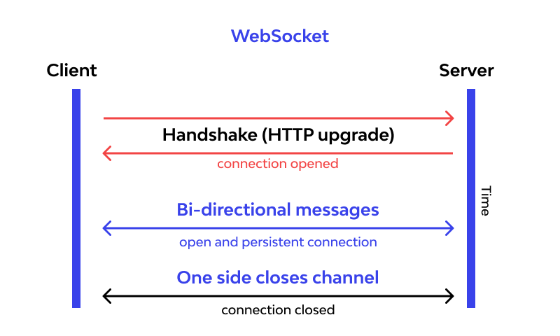
What is Websocket
WebSocket is a communications protocol for a persistent, bi-directional, full duplex TCP connection from a user's web browser to a server.
A WebSocket connection is initiated by sending a WebSocket handshake request from a browser's HTTP connection to a server to upgrade the connection.

Slide 4
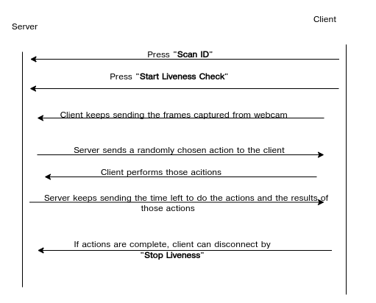
Demo App Communication

Slide 5
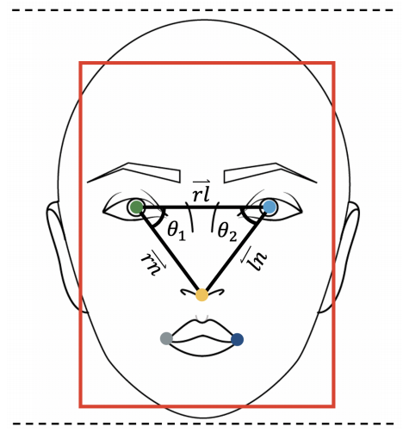
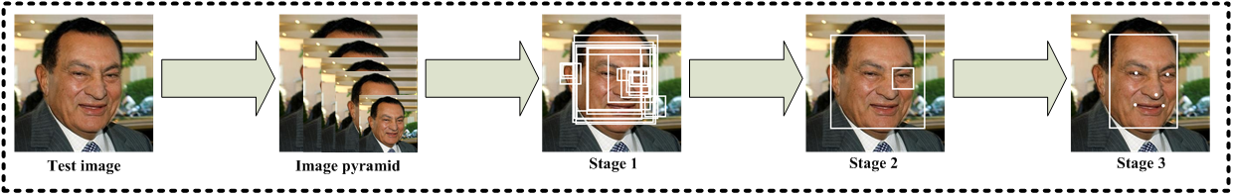
Face Profile Detection Model
Model Used - MTCNN(Multi-Task Cascaded Convolutional Neural Networks)
Accuray on FDDB and WIDER FACE dataset - 95.4 %
WIDER face dataset(32, 203 Images) : http://shuoyang1213.me/WIDERFACE/
FDDB dataset(2,845 Images) : http://vis-www.cs.umass.edu/fddb/index.html
3 stages of MTCNN:
Stage 1 : Face Classification
Stage 2: Bounding box regression
Stage 3 : Facial Landmark Localization
To get profiles(left/right) of faces: Compare angles of obtained landmarks from MTCNN.

Slide 6
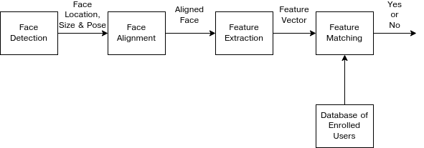
Face Matching Model
Accuracy on LFW(Labeled Faces in the Wild Home) dataset(13,233 Images) http://vis-www.cs.umass.edu/lfw/ -> 99.38 %
Steps for Face Matching:
Face detection -> Using HOG(Histogram of Oriented Gradients) algorithm
Face Alignment -> To centre the image
Feature Extraction -> Pass encodings of the face to pre-trained ResNet model , which gives 128 measurements/landmarks of face
Face Matching -> SVM(Support vector machines) classifier gives the distance between extracted. landmarks of 2 faces.

Slide 7
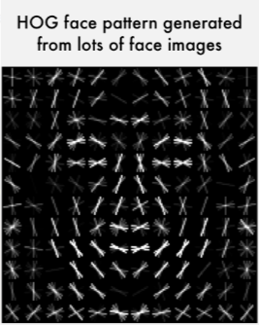

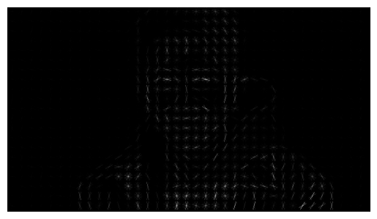
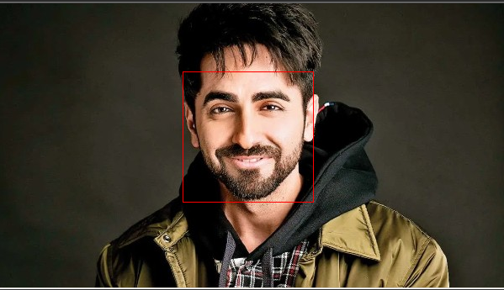
Step 1: Face Detection
To determine the bounding box of present human faces in an image.
Histogram of Oriented Gradients(HOG).
To find faces in this HOG image, all we have to do is find the part of our image that looks the most similar to a known HOG pattern that was extracted from a bunch of other training faces.
Generate Hog
Bounding Box
Compare

Slide 8

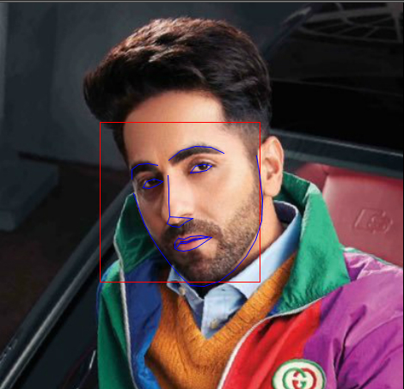
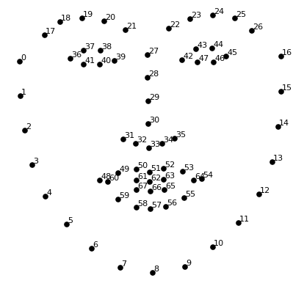

Step 2: Posing and Projecting Faces
Faces can be oriented, that looks different to a computer.
68 specific points (called landmarks) that exist on every face — the top of the chin, the outside edge of each eye, the inner edge of each eyebrow, etc. are used.
Landmarks of a face are projected onto these 68 known specific points..
To do this, we are going to use an algorithm called face landmark estimation.

Slide 9
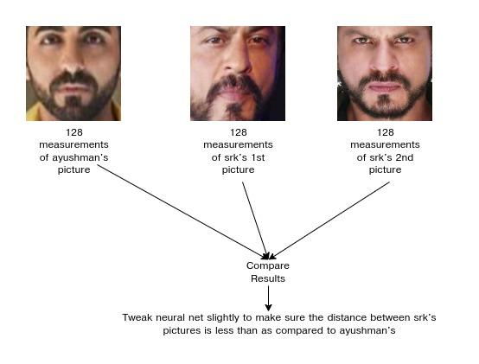
Step 3: Encoding Faces
How to differentiate faces from each other?
Extract 128 basic measurements from each face. These measurements are called as embeddings. Then we could measure our unknown face the same way and find the known face with the closest measurements..

Slide 10
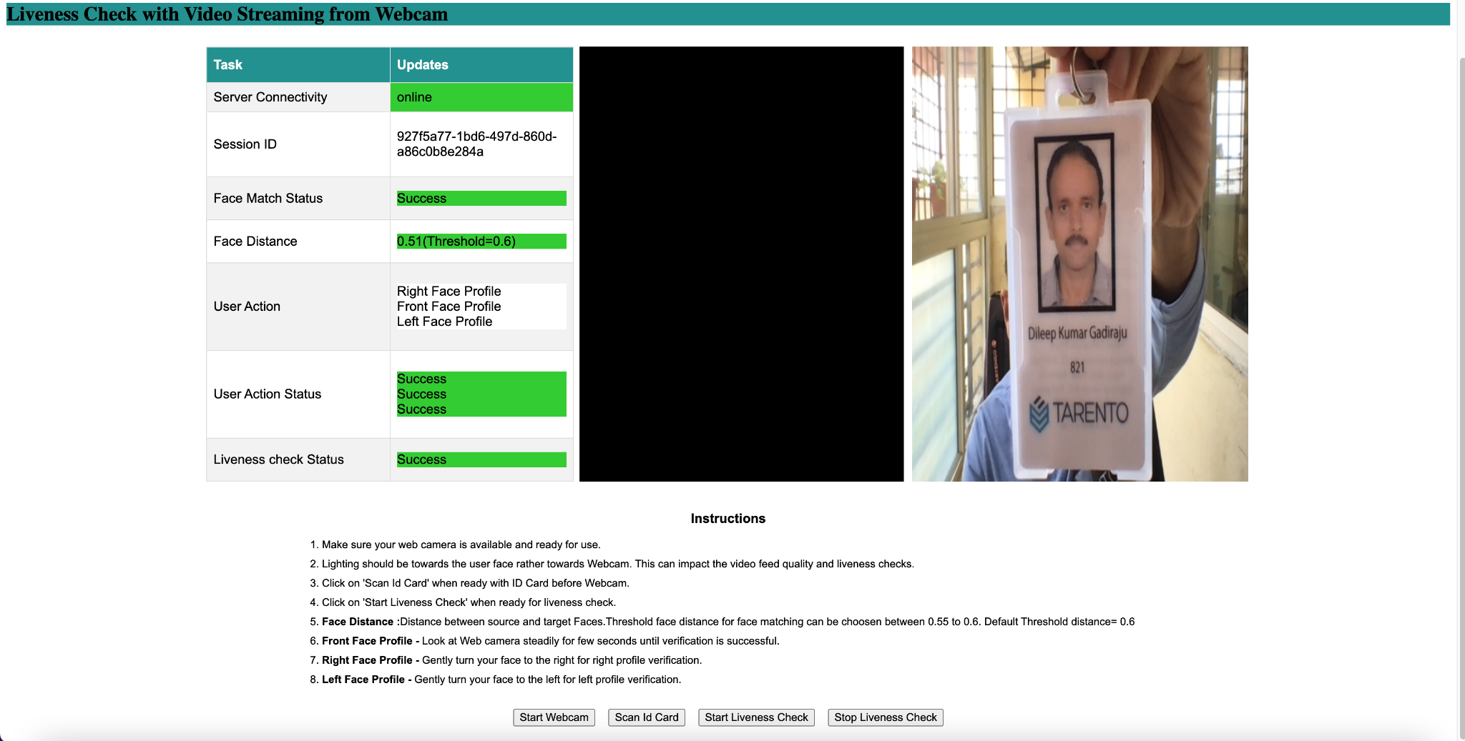
Demo

Slide 11
Face Recognition Experiments Repository
https://github.com/dileep-gadiraju/face-recog-experiments

Slide 12
Q&A

